Slide 1
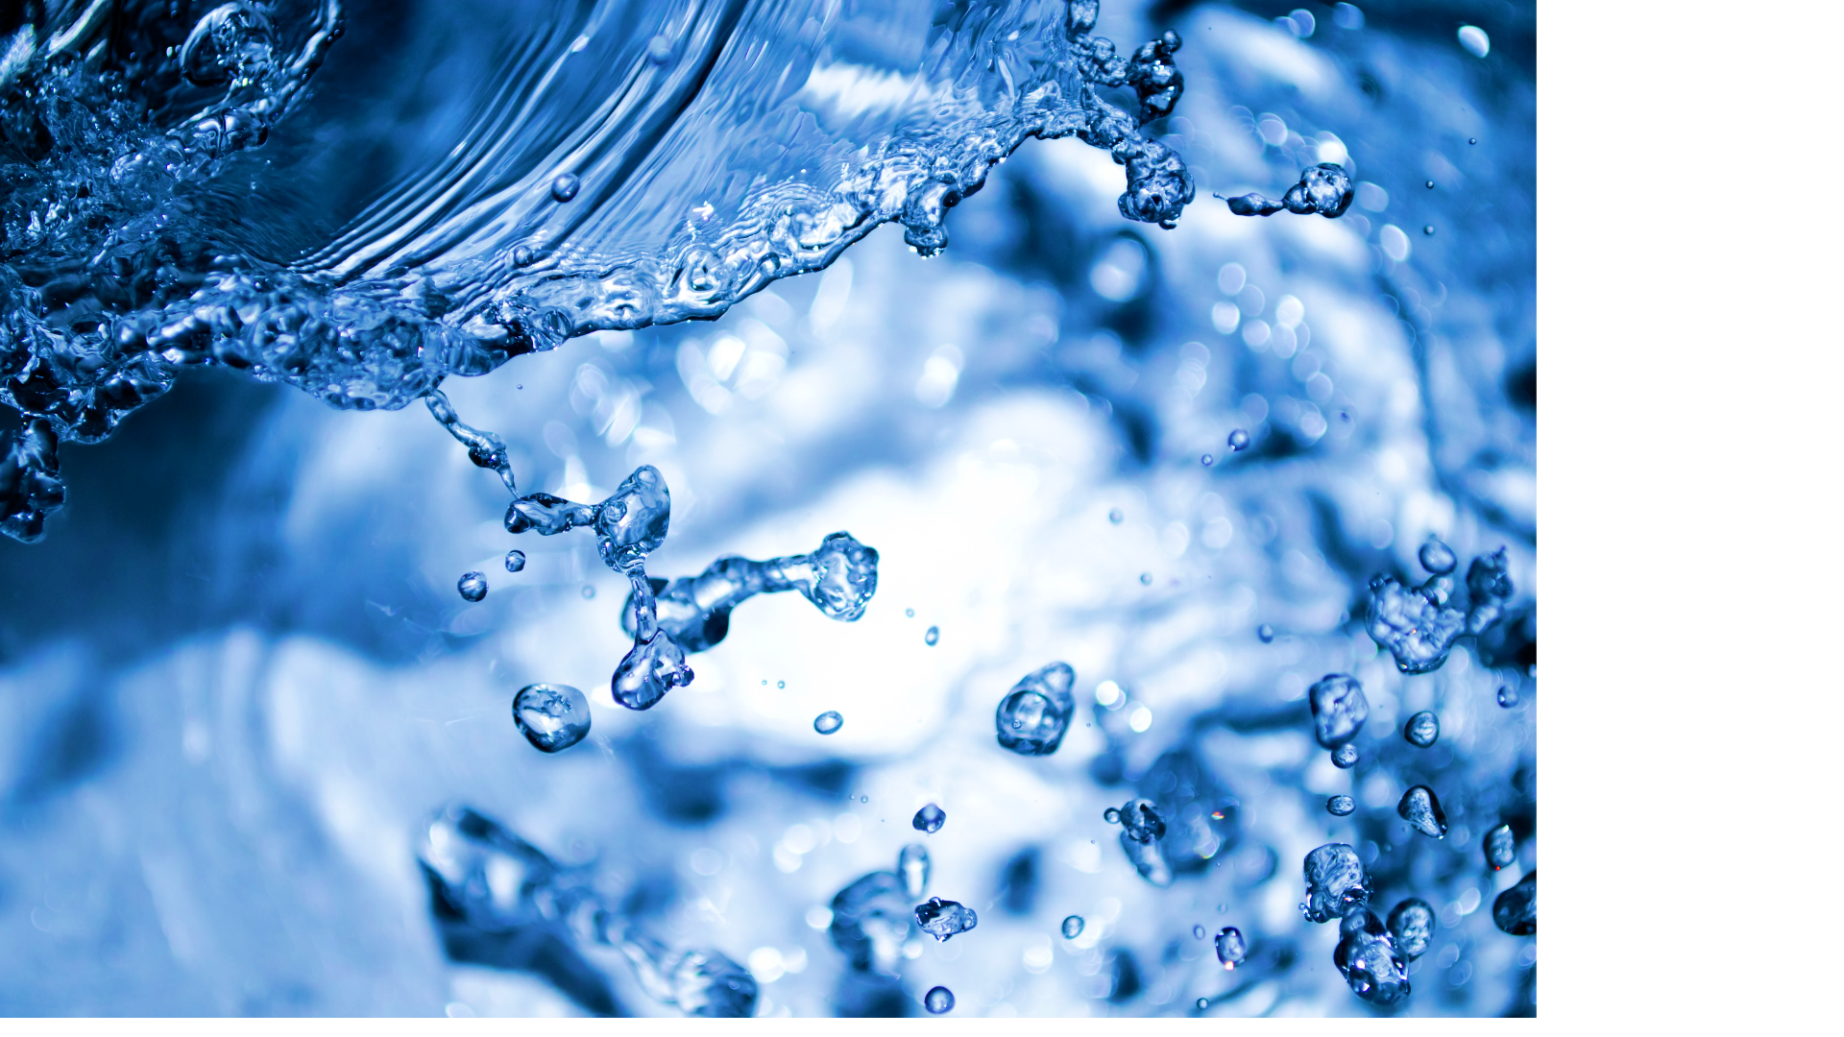



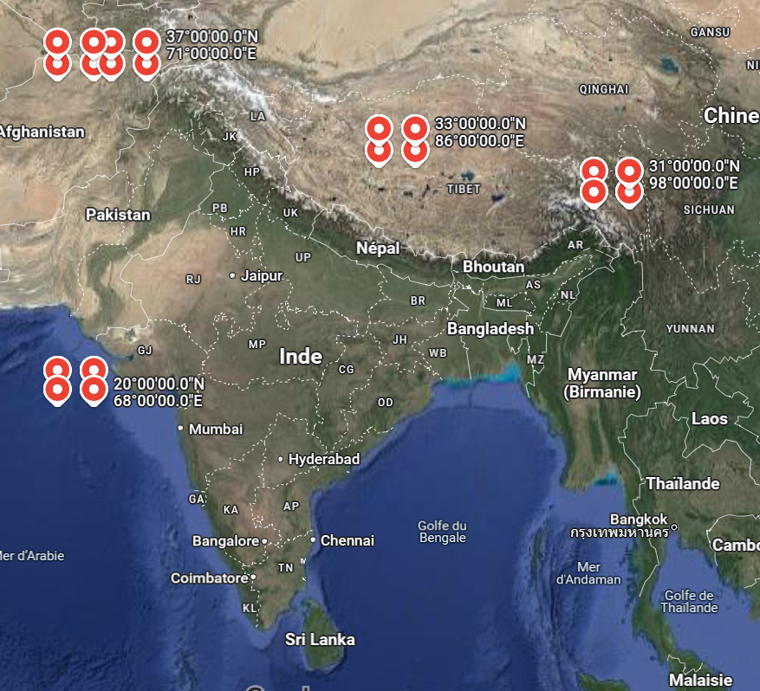


F7: Predicting Flooding Probability in India
by Christian Laurio and Theo Guilbert-Hattermann
INTRODUCTION
OBJECTIVES
Floods have always been a relevant topic in India, especially due to the “Indian monsoon” phenomenon. This climatic event is a major wind system that seasonally reverses its direction. In India, the wind blows from the northeast during cooler months and reverses direction to blow from the southwest during the warmest months of the year. At the same time, in early summer, the lands and the Himalaya mountains heat up, so that hot air climbs up. Consequently, when the southwest wind meets this warm air, it creates large amounts of rainfall in the country during June and July.
Many factors contribute to flooding, but experts say climate change caused by global warming makes extreme rainfall more likely. India has experienced increasingly extreme weather in recent years, where unrelenting rains came just weeks after an extreme heat most of north India. For instance, in June 2022, 32 of its 35 districts have been affected by the tremendous floods, killing 45 people and displacing more than 4.7 million over one week.
RESULTS
CONCLUSION

Slide 2
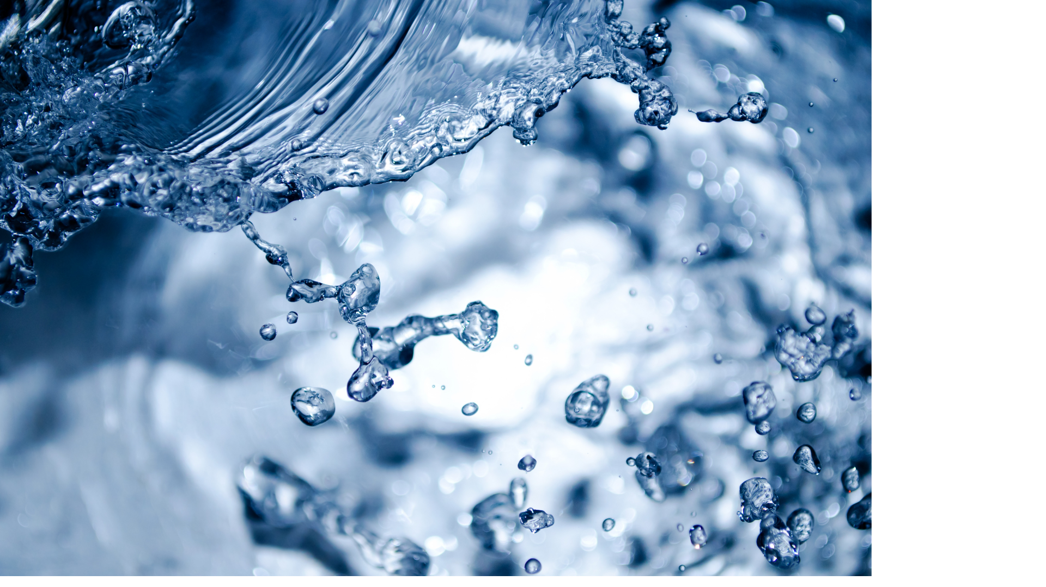

Flood Risks in India
A little bit of context…
Floods have always been a relevant topic in India, especially due to the “Indian monsoon” phenomenon. This climatic event is a major wind system that seasonally reverses its direction. In India, the wind blows from the northeast during cooler months and reverses direction to blow from the southwest during the warmest months of the year. At the same time, in early summer, the lands and the Himalaya mountains heat up, so that hot air climbs up. Consequently, when the southwest wind meets this warm air, it creates large amounts of rainfall in the country during June and July.
Many factors contribute to flooding, but experts say climate change caused by global warming makes extreme rainfall more likely. India has experienced increasingly extreme weather in recent years, where unrelenting rains came just weeks after an extreme heat most of north India. For instance, in June 2022, 32 of its 35 districts have been affected by the tremendous floods, killing 45 people and displacing more than 4.7 million over one week.
Project Goal
This project aims to analyze and construe floods in India over the years, in order to identify the relevant features and then build a predictive flood model. Thanks to these information, we could extract some insights for policy makers and apply flood control measures at the end. The final predictive model must indicate if floods will occur or not, thanks to machine learning algorithms.

